Slide 2
Welcome to Recruitment 101!
Proudly Presented by the
Greater Kansas City Alumnae Panhellenic
Follow us on Instagram
@gkcalumnaepanhellenic
Follow us on Facebook
https://www.facebook.com/KCPanhellenic
Notes:
Welcome thanks for coming out today. We hope you find this information helpful. Give us a follow on Instagram and/or Facebook for great information and updates on things happening with sorority in Kansas City!

Slide 3
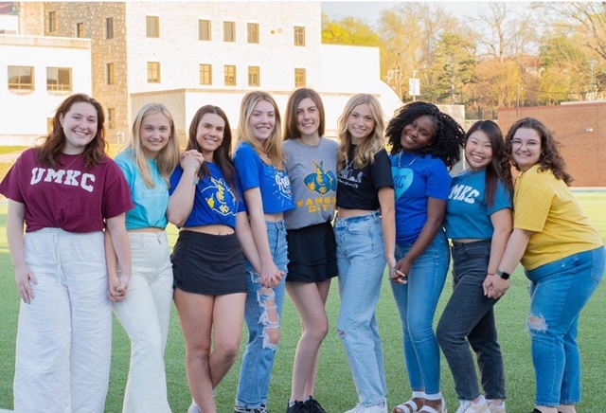
We are so glad that you are here!
Share your name
What high school you attend
What college/university you will attend this fall/spring!
Notes:
Let’s get started with some introductions. The alumnae panhellenic members in the room today represented many different organizations and we purposely do not share our affiliation.
Alumnae Panhellenic Introduce themselves
Next Students and guests introductions

Slide 4
Learn
more about NPC
The National Panhellenic Conference is the premier advocacy and support organization for the advancement of the sorority experience
NPC is made up of 26 member organizations
Greater KC Alumnae Panhellenic Association is an active Alumnae Chapter with NPC
Our goal is to promote sorority awareness, scholarships, service and the lifetime membership experience in the KC Metro area.
Notes:
Made up of 26 member organizations, the National Panhellenic Conference is the world’s largest umbrella organization specifically charged with advancing the sorority experience.
The GKC Alumnae Panhellenic Association is an active alumnae chapter with the National Panhellenic Conference (NPC). The purpose of the associations is:
To promote a friendly, inter-fraternity relationship among KC alumnae, to support local collegiate
National Panhellenic Conference associations and to be a forum for the discussion of all questions of general interest to the fraternity world.
To establish and maintain a Scholarship Fund for the aid of worthy students.
To promote fraternity awareness in the metropolitan area in order to increase fraternity membership.

Slide 5
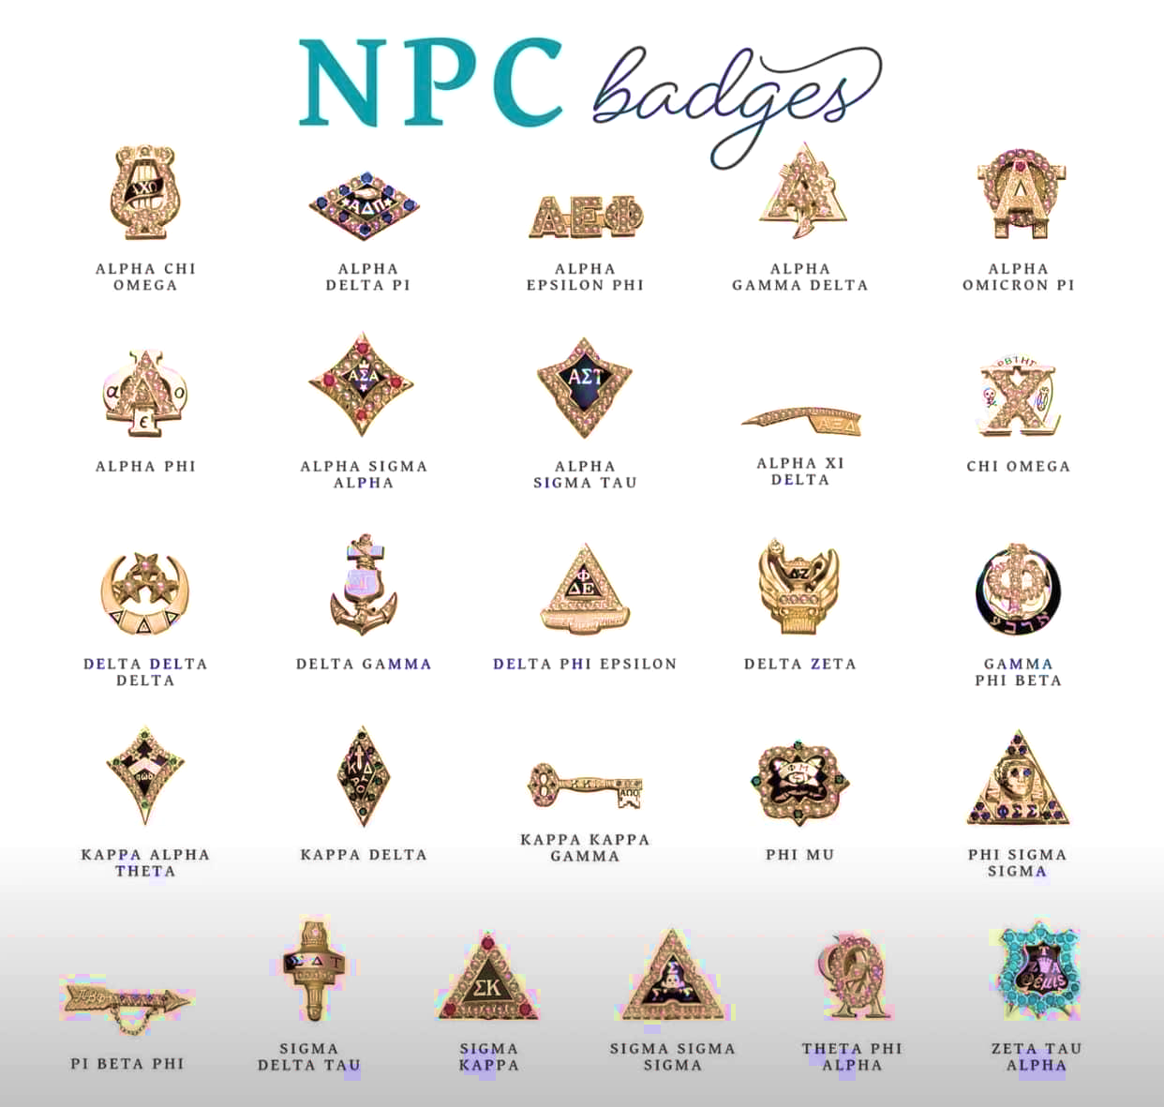
Notes:
All 26 organizations have special badges, as well as new member badges that you will wear before Initiation. There is not a campus that has all 26 groups, so you will see some combination of these sororities on your campus.

Slide 6
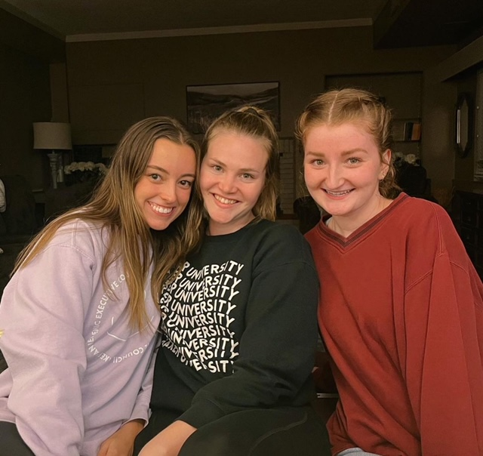
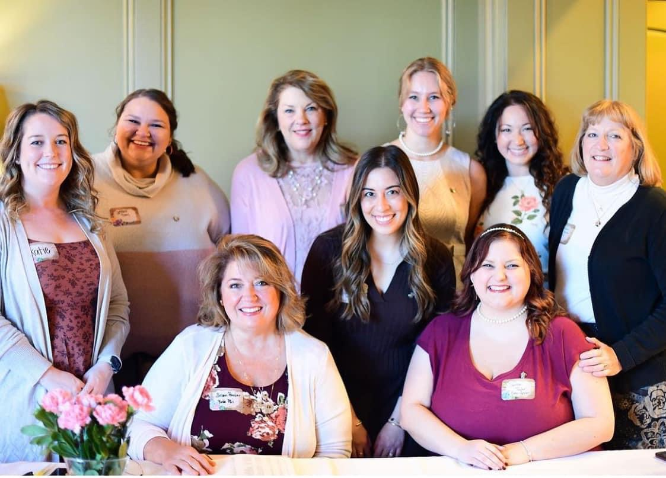
What is a Sorority?
A life-long support system that provides career and networking opportunities during college and for a lifetime
An organization that values academic excellence and lifelong learning
An organization that values philanthropy and community service
An opportunity for women to develop strong leadership skills
A great way to meet amazing friends who support one another
An opportunity to enjoy sisterhood events, date parties, formal dances and other fun social events
Notes:
Lifetime Experience – Most years in the room maybe?

Slide 7
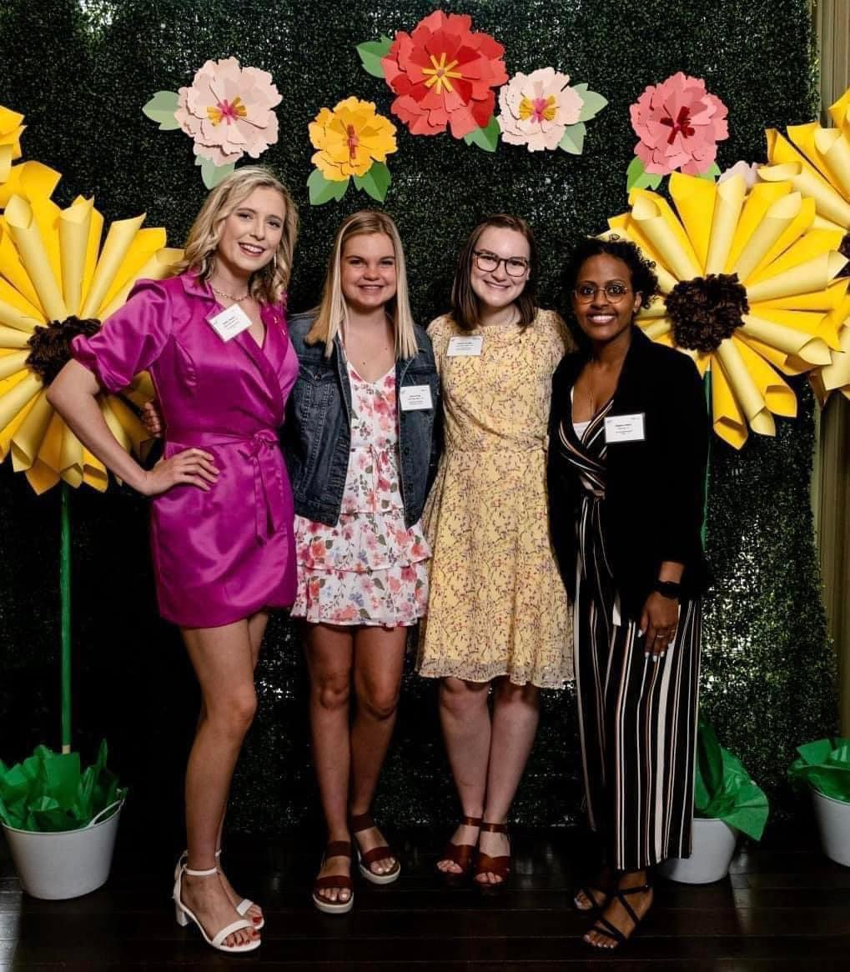
What a Sorority is Not
Stereotypical like you see in the movies
A group of women who put appearance and wardrobe ahead of values and personality
An organization that approves of hazing and other inappropriate behaviors
Something that you can only be involved in during college

Slide 8
Let’s Talk Recruitment
Primary/Formal Recruitment
Rounds
Possible Virtual Open House
COR/COB/Open Recruitment
I have heard ______________ about Recruitment.
Notes:
Primary Recruitment is the chance to explore all chapters on your campus. About 75% of NPC groups have Primary in the Fall, and the others do it in the Spring. You may have heard of COR/COB/Open Recruitment…that is very common today! With COR, chapters participate if they have open spaces as set by Panhellenic. PNM’s do not know who has spaces in COR until just prior, and the number of spaces vary.
Myths about Recruitment – ONE big one is that “there aren’t enough spots for all”. That is not true! There is a lot of math and data analytics that go into the back end of recruitment. Quota, the number of spaces available, is taken by the number of PNM’s who are still in the process at Preference round, divided by the number of chapters on campus. That number sets the number of new members in Primary Recruitment, which is the same for all groups.

Slide 9
Formal/Primary Recruitment
PNM- Potential New Member
Recruitment Counselors- various names
Meeting sorority women
Conversations
Positive PNM Contact
Notes:
Potential New Member
A Recruitment Counselor is an upper-class member of a sorority who is disaffiliated from her particular chapter and has been selected to serve as a counselor to potential members during the recruitment process. ... Potential New Members will work with their Recruitment Counselor throughout the fall and formal recruitment.
At every sorority, every day, you will get to talk to multiple women in that chapter. As the women get to know you they will probably ask about your major, your passions, where you’re from. The overlooked part is that you are also getting to know them. You can ask them the same questions. In fact, it is encouraged. What sorority you join is up to you so take this valuable time to get to know the women. You should also ask about their organization. What sisterhood or philanthropy events do they hold? What kind of academic support do they provide? Use this time to get to know each chapter and ask about things you value. For example, if you value being in an organization that is service oriented, you can ask the member(s) you meet about the service opportunities provided by the chapter.
Recruitment is a mutual selection process that balances the preferences of each potential new
member with those of the existing Panhellenic sorority chapters. The Panhellenic Association
strives to allow every woman an opportunity to find a sorority that best suits their personality,
interests, and future goals, while providing an organized and unbiased membership selection
process for the chapters.
Invitations are only guaranteed to potential new members for the first round. There is no
guarantee that a PNM will be invited to attend the second, third, or fourth event rounds.
Invitations to subsequent rounds are made based on the selections of the chapters and the
preferences of the potential new members. PNM schedules will be maximized so they are able to
meet with as many chapters as possible during their recruitment experience.
There is no guarantee that a woman will receive a bid to any sorority. However, if a potential
new member progresses through the week and attends all the events that they are invited to, and
during the fourth round lists each of chapter(s) they attend on their preference sheet that night,
they will receive a bid to one of those chapter(s).
There is no specific formula that explains why a woman is released from a particular chapter,
or why a woman prefers one chapter more than another. The Panhellenic Association makes
every effort to allow each potential new member the best opportunity to join a sorority, but there
are no guarantees that a woman will be placed within a specific sorority. It is important to keep
an open mind during recruitment week and to use the time to meet and make new friends!

Slide 10
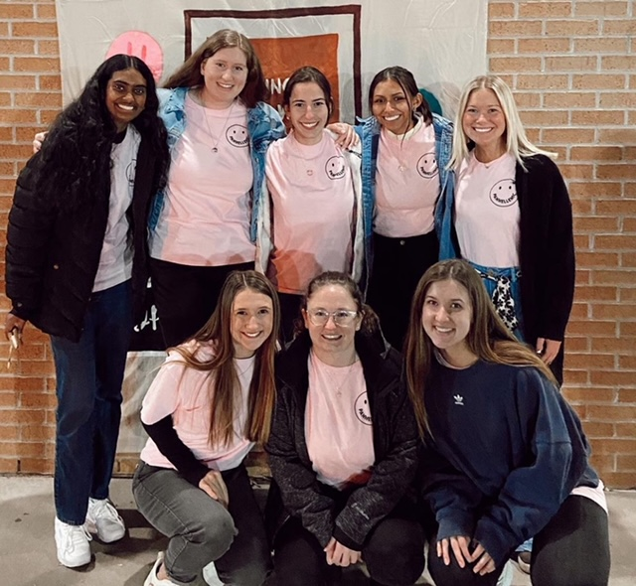
Formal/Primary Recruitment
Mutual Selection process
MRABA – Membership Recruitment Acceptance Binding Agreement
Bid Day
http://thesororitylife.com/potential-members/learn/how-does-recruitment-work/
Notes:
The MRABA is a binding contract after Preference. This says that you would accept a bid from any sorority that you write down. The MRABA binds you for one calendar year.

Slide 11
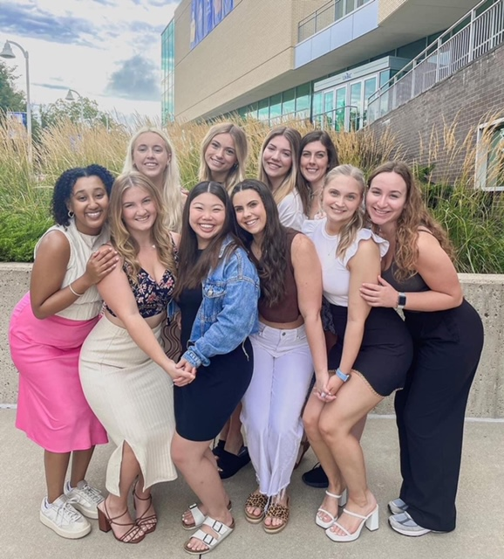
Success Strategies
Do your research
Social Media
Be YOURSELF!
Be polite and stay positive
Be prepared to ask questions and avoid controversial topics
Get plenty of sleep, wear comfortable shoes and stay hydrated
Take notes
Try to avoid into the “lawn talk”
Keep an open mind!
Notes:
The only opinion of each chapter that should affect
your decision is yours. Chapters vary from campus
to campus and from year to year depending on
membership. If you allow someone else's perceptions
to influence you, you may not be satisfied with your
choice in a sorority. Each chapter is made up of
women with a range of personalities and qualities. If
you hear any derogatory remarks about a particular
chapter or sisters, we ask you to please inform your
recruitment counselor and to disregard them.

Slide 12
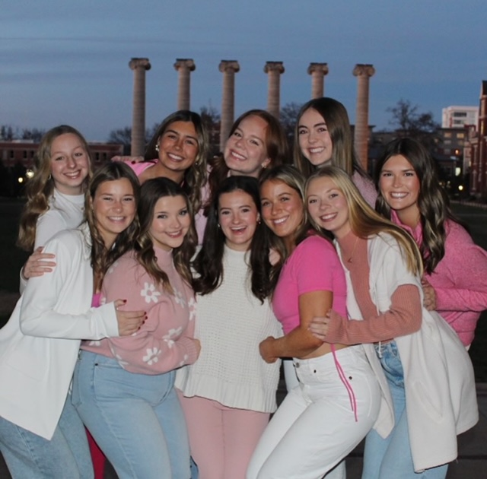
Things to know!
Financial obligations
Housing obligations
Time commitment
Notes:
Panhellenic sororities are not-for-profit organizations, meaning they count on the dues of their members to function. All sorority finances are handled through each organization, not the University. Every chapter manages their finances differently. Some chapters split their payments into installments throughout the semester while other chapters have their dues paid in one lump sum at the beginning of the semester. The items included in a member’s dues are also unique to each chapter. Some chapters include items such as an activity fee, social fee, room, board, new member education, initiation fee and other fees in their dues. Other chapters have a base fee with a la carte fees throughout the year. In addition, chapters may manage their finances through the internet or through the finance chair of the chapter directly. Each chapter will discuss their own specific financial commitments during the socials on philanthropy day.
Housing Commitments – generally one year, but please be sure to ask!
Time Commitments – chapter meetings, philanthropy events, recruitment participation, social events, leadership

Slide 13
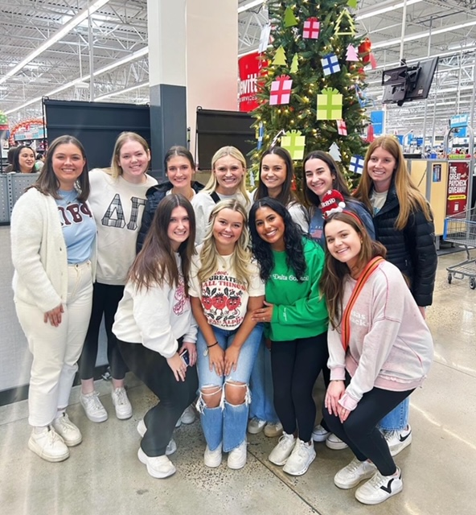
Preparing for Recruitment
Follow your Campus Panhellenic on Instagram for updates and information
Review your Social Media (all platforms)
Be aware all campus Recruitment registration deadlines and fees
Recruitment Forms
Paperwork, videos, photos
Legacy Information & Introductions
Alumnae, please check legacy policies for your organization, as many have changed in the past few years
Notes:
The only opinion of each chapter that should affect
your decision is yours. Chapters vary from campus
to campus and from year to year depending on
membership. If you allow someone else's perceptions
to influence you, you may not be satisfied with your
choice in a sorority. Each chapter is made up of
women with a range of personalities and qualities. If
you hear any derogatory remarks about a particular
chapter or sisters, we ask you to please inform your
recruitment counselor and to disregard them.

Slide 14
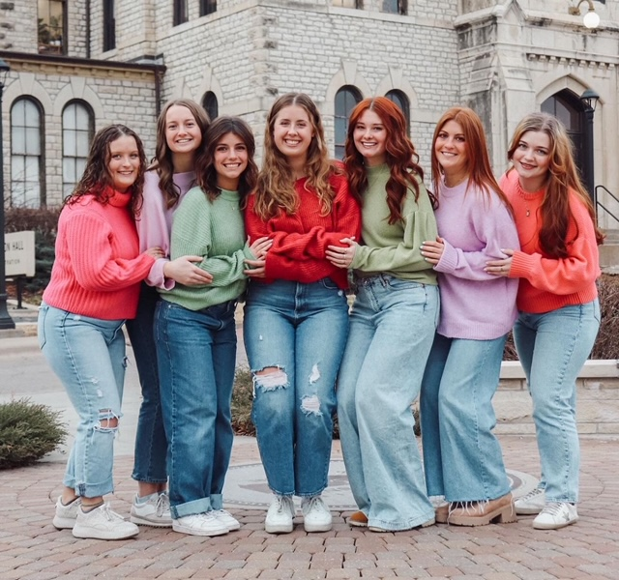
Preparing for Recruitment
Alumna Recommendations
NPC does NOT require recommendations, and some NPC groups are moving away from accepting them
The best recs come from people that you PERSONALLY know
Introduce Yourself Forms
Notes:
The only opinion of each chapter that should affect
your decision is yours. Chapters vary from campus
to campus and from year to year depending on
membership. If you allow someone else's perceptions
to influence you, you may not be satisfied with your
choice in a sorority. Each chapter is made up of
women with a range of personalities and qualities. If
you hear any derogatory remarks about a particular
chapter or sisters, we ask you to please inform your
recruitment counselor and to disregard them.

Slide 15
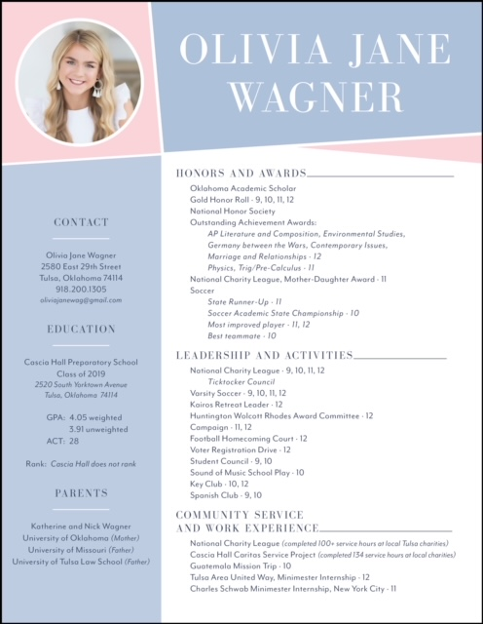
Recruitment Resume Examples
Headshot
Show your personal style with the aesthetic
Clear and easy to read
Notes:
These are not required, but are a great way to have all of your information in one place! This is especially helpful when reaching out for recommendations or speaking with alumnae about recruitment.

Slide 16
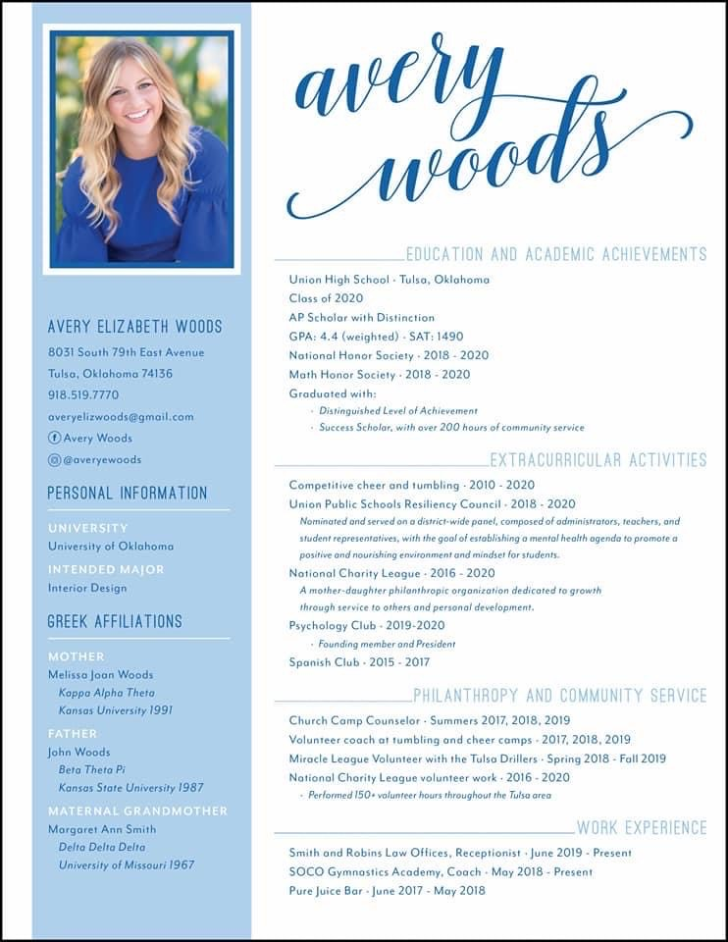
Name, Address, Email, Social Media handles
Academic Info: GPA, ACT/SAT, scholarships
Activities & Leadership
Philanthropy &Community Service
Work Experience
Legacy Information – seeing less of this
You can find examples or templates in a Google Search!
Make your own on Canva or check out Etsy for ideas!

Slide 17
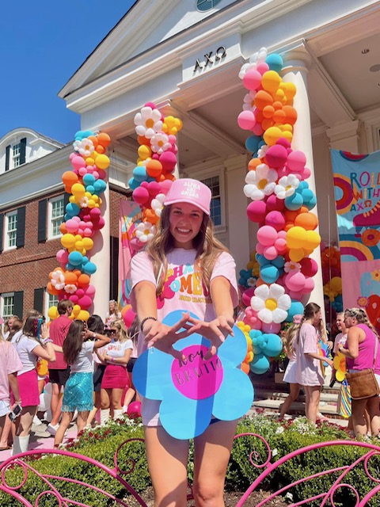
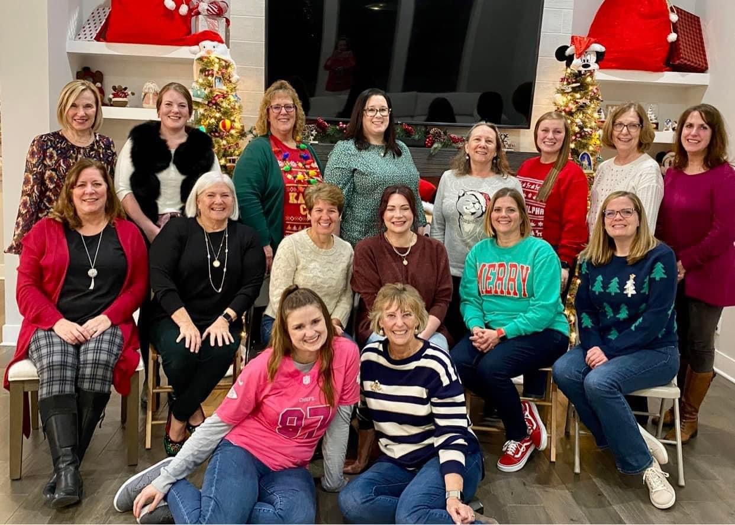
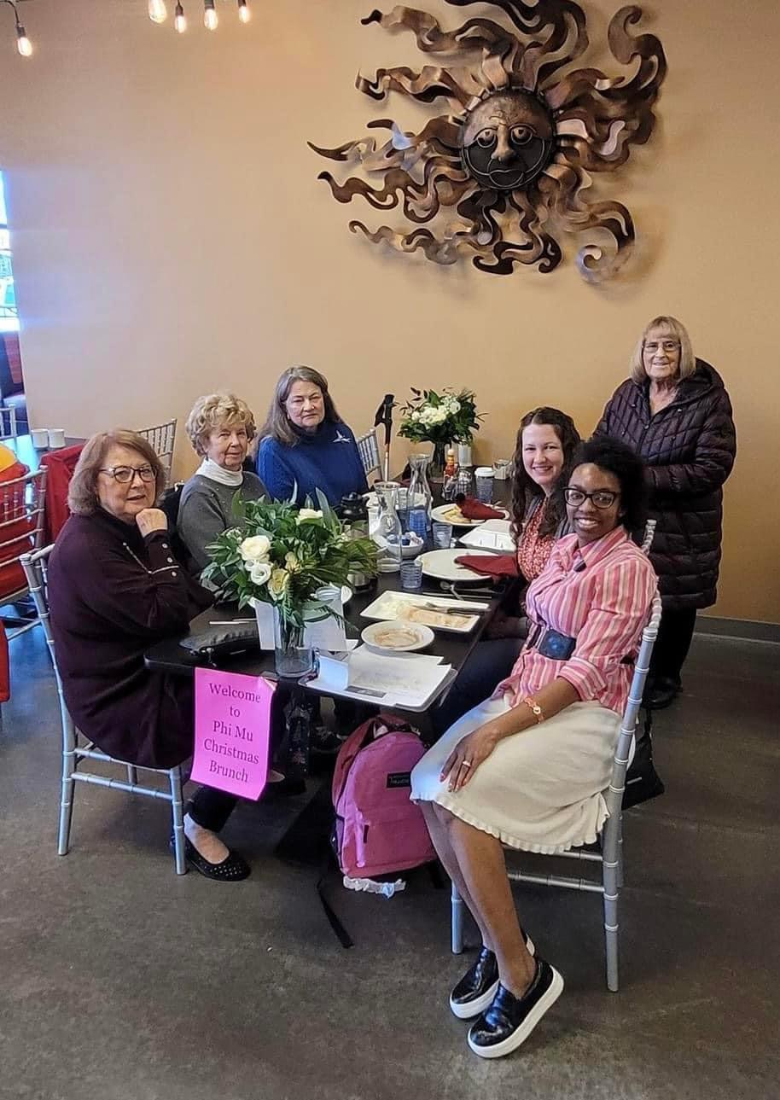
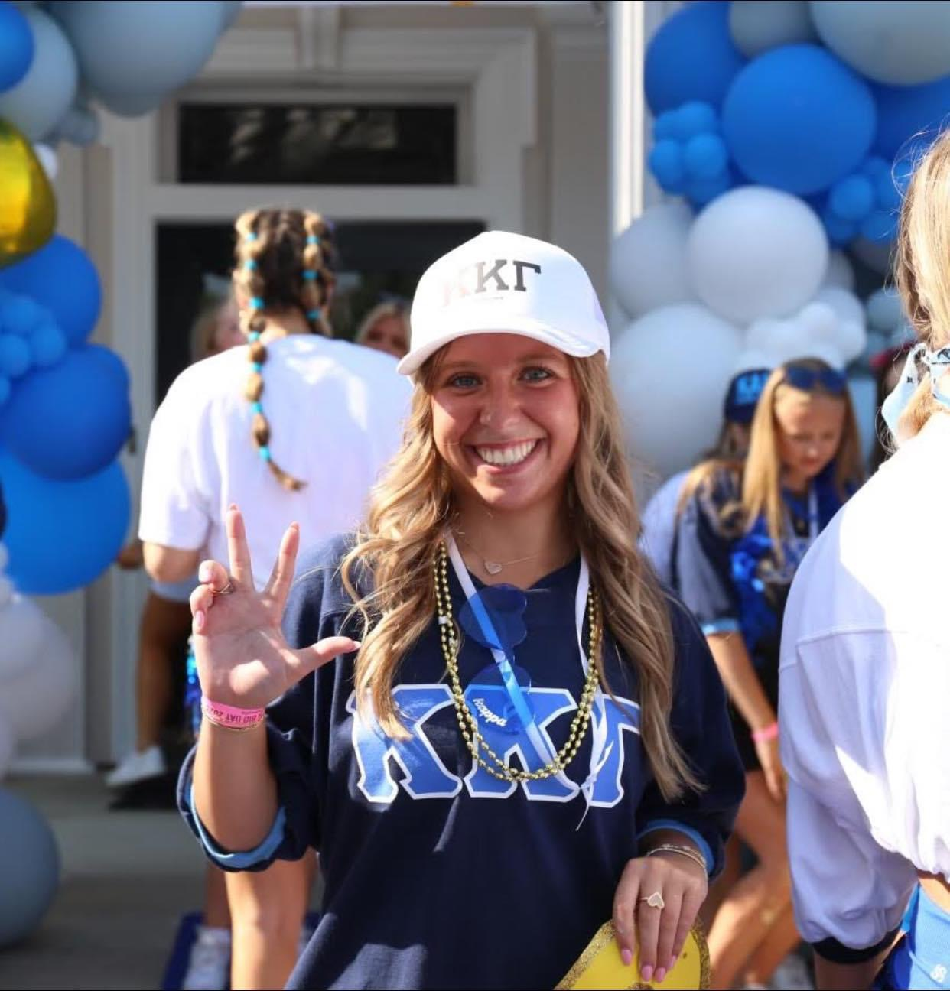
There are many clubs and organizations to join on your campus, but being in a Panhellenic Sorority is TRULY a Lifetime Membership Experience!

Slide 18
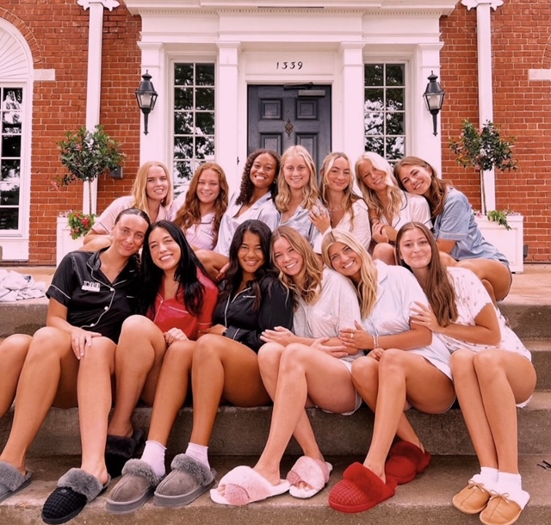
Resources
http://kcpanhel.com
https://www.npcwomen.org/
https://www.facebook.com/NPCWomen/
https://thesororitylife.com/
https://www.facebook.com/thesororitylife/
https://www.instagram.com/sororitylifenpc/

